Slide 1

Is a medal about the athlete, or the sport?
Ali Yusuf Al Basri

Slide 2
Problem statement
Across 261,507 Olympic athlete records from 1896 to 2016, win rate ranges from 4.9% in Alpine Skiing to 28.7% in Hockey among sports with more than 5,000 records, a nearly 6x gap. Judging sports on results alone, without accounting for this gap, can mislead decisions on where to develop athletes.

Slide 3

Aim
Show how much medal odds differ between Olympic sports, and identify which sports have the highest and lowest win rates.

Slide 4
Objectives
What is the overall win rate across all athlete records, 1896-2016, and how many sports and events does it cover?
How do the 18 sports with 5,000+ records rank by win rate, from highest to lowest?
What is the win rate in Summer vs Winter Games, and how large is the gap?
How does win rate differ across age, height and weight groups?
How do early-Games win rates (1890s, about 46%) compare with modern decades (about 14%)?
Do sex, season, age, height and weight change which medal (Gold, Silver or Bronze) an athlete wins?

Slide 5
Dataset overview
athlete records : 261,507
Overall win rate: 14.9%
Total sports:
66

Slide 6
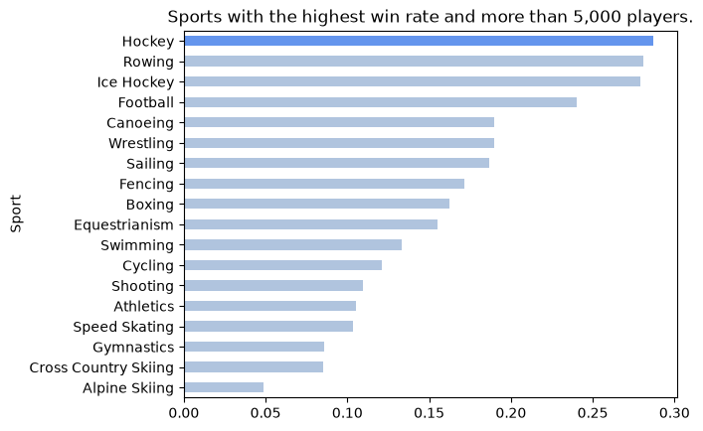

Slide 7
Findings: sports
Hockey (28.7%), Rowing and Ice Hockey (both about 28%) and Football (about 24%) lead.
All four leaders are team sports, where one medal counts for the whole roster.
Alpine Skiing (4.9%), Cross Country Skiing (about 8.5%) and Gymnastics (about 8.6%) sit at the bottom.
The spread from top to bottom is nearly 6x.

Slide 8
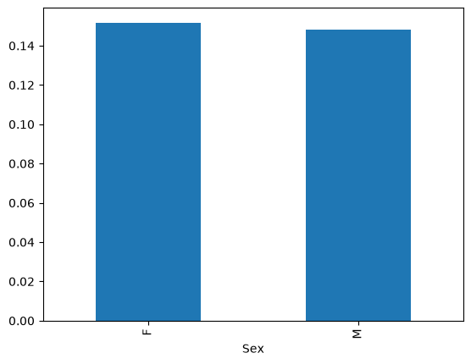

Slide 9
Finding: win rate by sex
Women win medals at 15.1% and men at 14.8%, a gap of only 0.3 percentage points. Sex has almost no effect on the chance of winning.

Slide 10
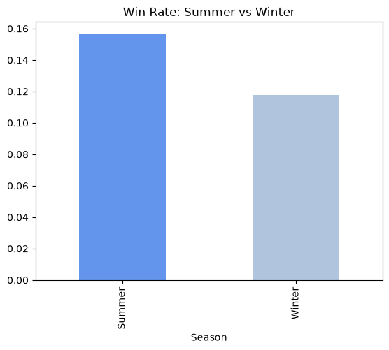

Slide 11
Findings: season
Summer Games win rate is about 15.6%.
Winter Games win rate is about 11.8%.
It’s slightly easier to win at Summer.

Slide 12
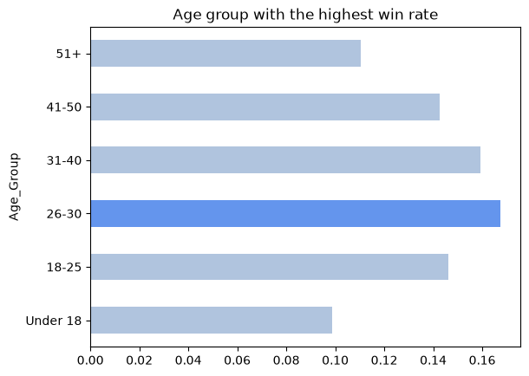

Slide 13
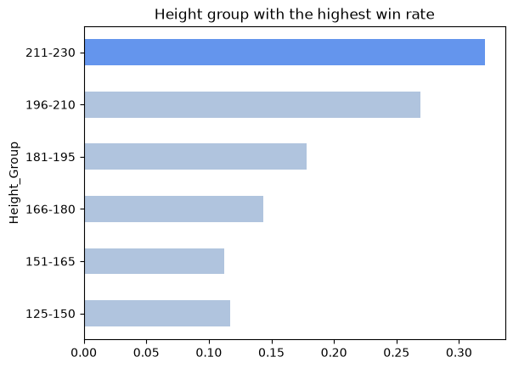

Slide 14
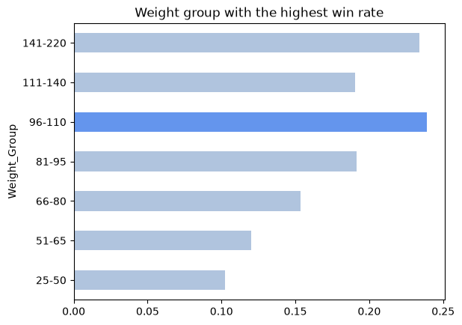

Slide 15
Findings: body and age
Age: win rate peaks at 26-30 (about 17%) and is lowest under 18 and 51+ (about 10-11%).
Height: the tallest group (211-230 cm) wins about 32%, versus about 12% for the shortest.
Weight: the 96-110 kg group peaks at about 24%.
Tall and heavy athletes cluster in team sports, so this may reflect the sport, not the body.

Slide 16
Does each attribute change which medal an athlete wins?

Slide 17
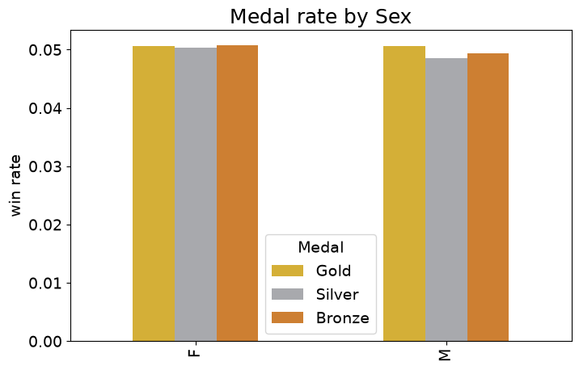

Slide 18
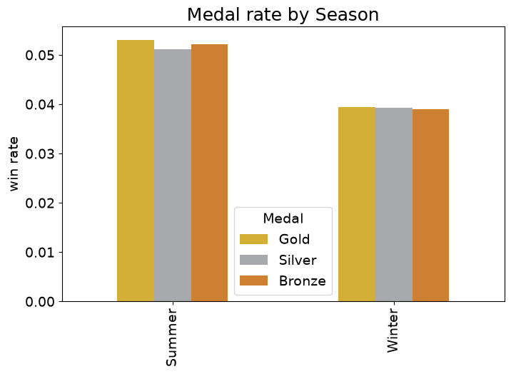

Slide 19
Findings: sex and season
Sex: Gold, Silver and Bronze are each about 5% for both women and men. Sex does not change the medal type.
Season: Summer is about 5% for each medal and Winter about 4%, so Summer is higher overall.
Within each season the three medals are almost equal, so season changes how often, not which medal.

Slide 20
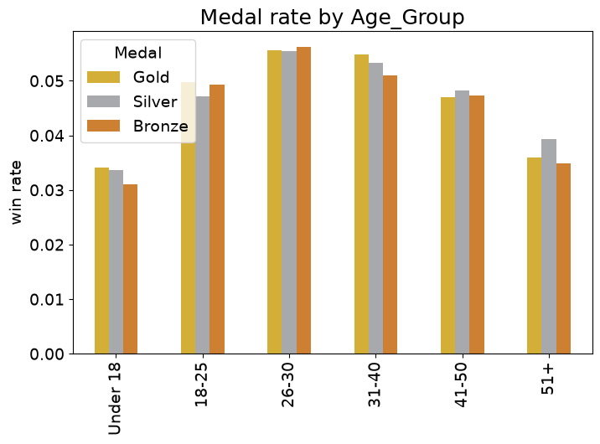

Slide 21
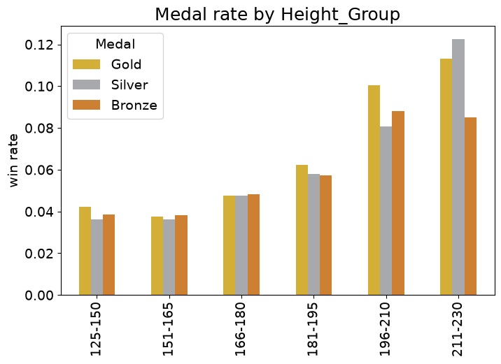

Slide 22
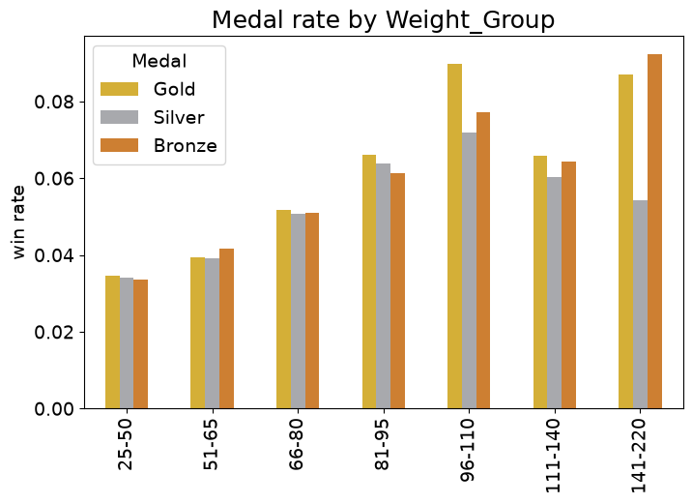

Slide 23
Findings: age, height and weight
Age: all three medals peak at 26-30 (about 5.5%) and are lowest under 18 and 51+ (about 3-4%). The three medals stay close within each group.
Height: medal rates climb with height, from about 4% (125-150 cm) to 9-12% (211-230 cm).
Height and weight: the medal split becomes uneven only in the tallest and heaviest groups (for example Silver leads at 211-230 cm).
Check group sizes and sport mix before trusting these gaps, since team sports may drive them.

Slide 24

Conclusion
Medal odds depend heavily on the sport, with a nearly 6x gap between the top and bottom.
Team sports lead partly because one medal is shared across a roster.

Slide 25
Thank You

